Slide 1

基于MindSpore的Falcon大模型迁移与性能研究
Triton&OneBit(stage 3)
Week 17
曾子瑄
2024.03.08
Notes:
照片为学生拍摄的礼堂

Slide 2
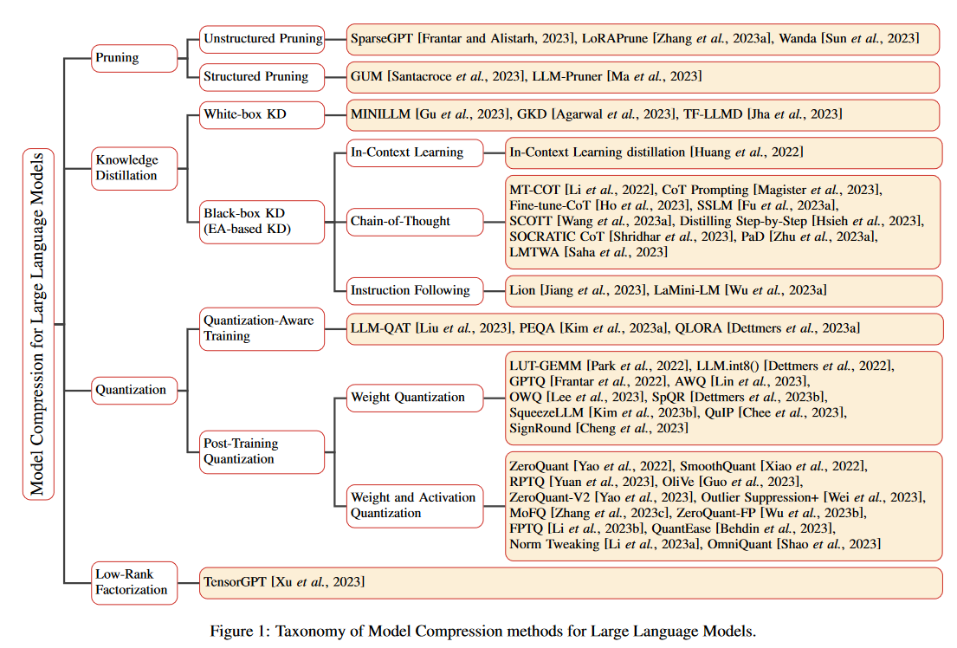
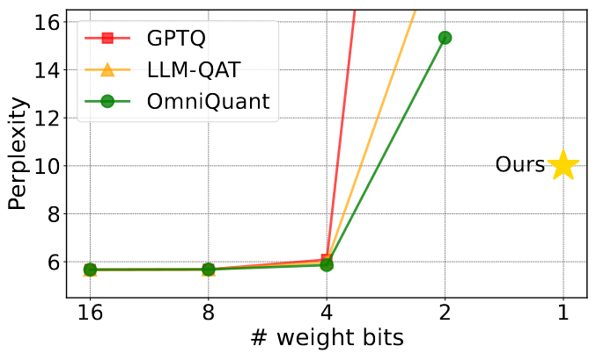
Background

Slide 3

Background
Post-training quantization(PTQ)
Quantization-aware-training(QAT)
Round-To-Nearest(RTN)
1bit precision
s denotes the quantization scale parameter,
z denotes the zero point parameter,
N is the quantization bit-width,
Clip(·) truncates the result in the range of 0 to 2N − 1.

Slide 4
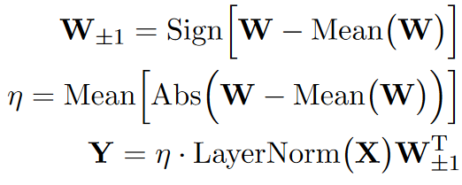
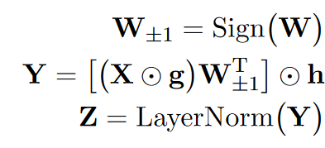
Method
1-bit Linear Layer Architecture
W denotes the quantized weight matrix with the shape m×n
W±1 denotes the 1-bit quantized matrix,
X is the input of Linear layer,
Y is the output.
g and h are the two FP16 value vectors
reduces computational demands
Wang et al. (2023)

Slide 5
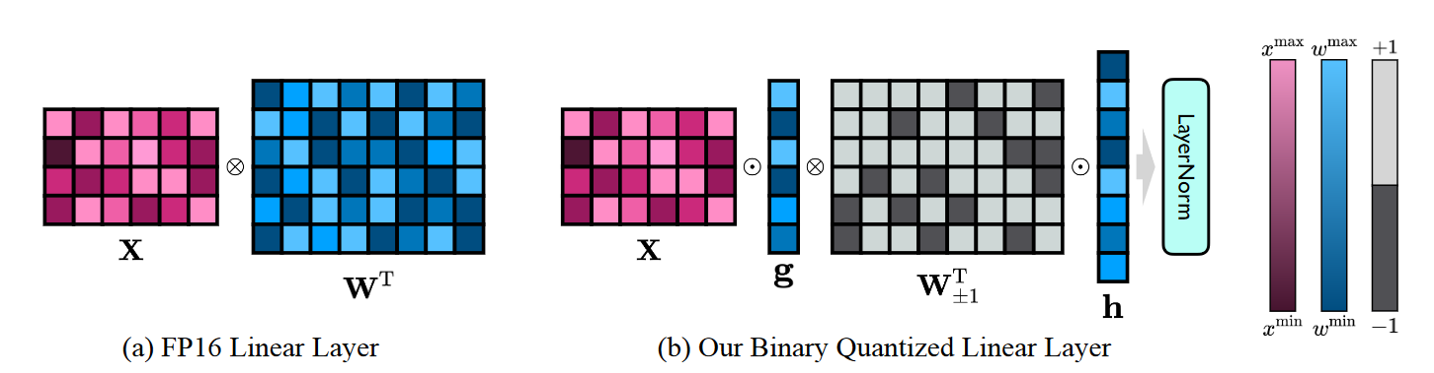
Method
when we quantize one weight matrix with the shape 4096 × 4096, the average bit-width of the quantized result is 1.0073

Slide 6






Method
Sign-Value-Independent Decomposition(SVID)
rank-1 approximation(SVD,NMF…)
Proposition 1

Slide 7



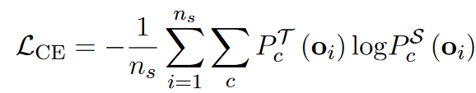
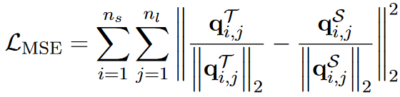

Method
Proposition 2
decomposition
Ei denotes the error matrices
Frobenius norm:
SVID is not aimed to precisely replicate the original model’s parameters, but to provide an effective starting point for further training
Knowledge Transfer
quantization-aware knowledge distillation
c denotes the number of classes,
ns denotes the number of training samples in the current batch,
T and S are the teacher model and student model.
nl denotes the number of layers,
q denotes the hidden state.

Slide 8
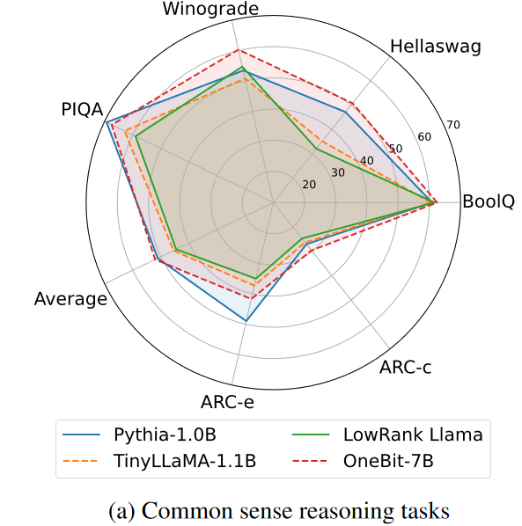
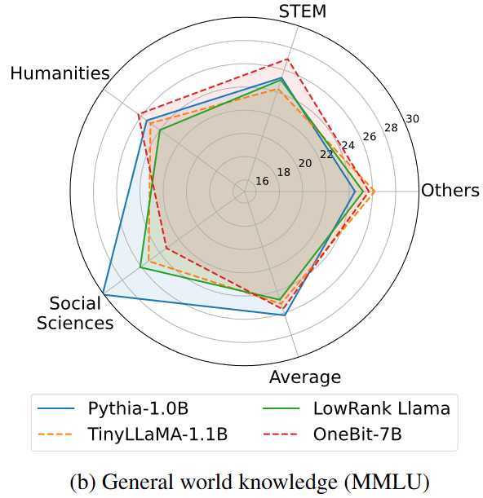
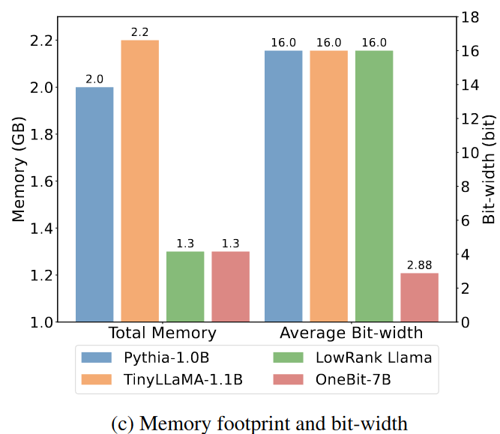
Experiments
Problem Solving Ability

Slide 9
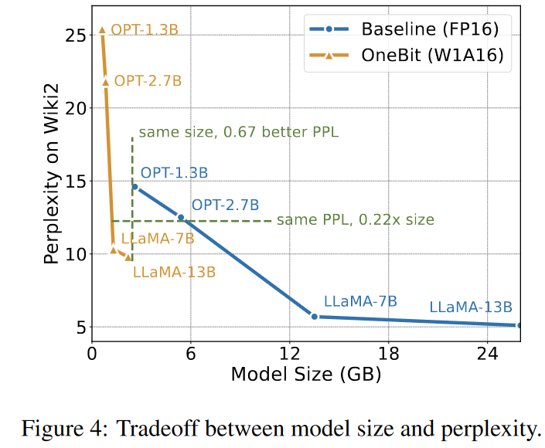
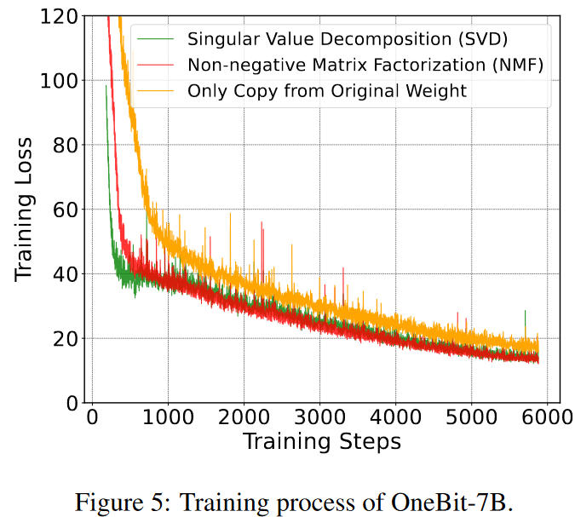
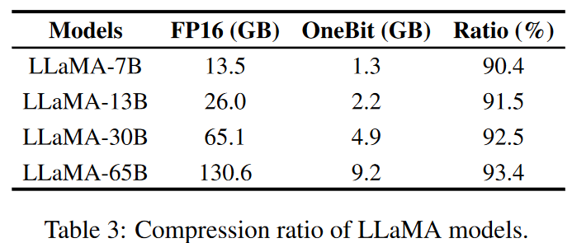
Experiments
Efficiency and Robustness

Slide 10
Conclusion
a model structure for 1-bit weight quantization and a corresponding parameter initialization method.
One-Bit has clear advantages over representative strong baselines and achieves a good tradeoff between model size and performance.
We further analyze the capabilities of such extremely low-bit quantized models.
Limitation
performance loss
the mathematical principles behind the optimal parameters of the 1-bit quantized model
method can not be naturally extended to higher bit-width
activation quantization

Slide 11
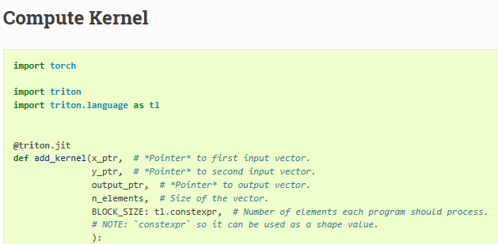
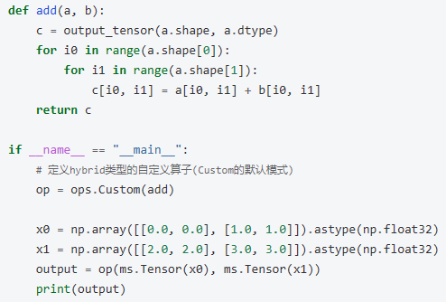
problem
torch.Tensor API
Vector addition example by Triton
JIT

Slide 12
JIT&AOT
AOT: AOT 编译是在程序运行之前将整个源代码或字节码文件一次性地编译成本地机器码。这意味着在程序运行时不需要再进行额外的编译工作，直接执行已经编译好的机器码。
JIT: JIT 编译是在程序运行过程中动态地将热点代码（频繁执行的代码）从字节码即时编译成本地机器码。JIT 编译器会根据实际的执行情况来选择需要编译的代码，并且可以根据优化策略对代码进行优化。

Slide 13
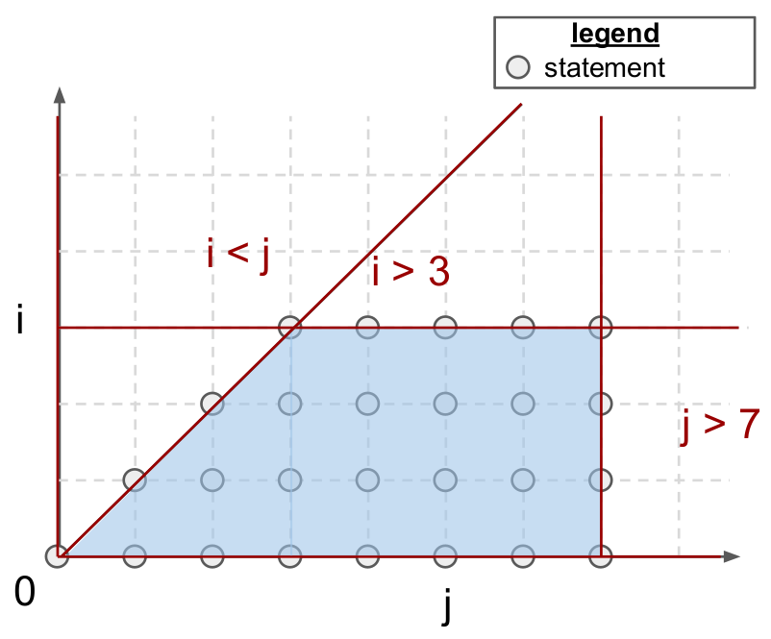
Polyhedral Model
optimize loops
for(int i = 0; i < 3; i++)
for(int j = i; j < 5; j++)
A[i][j] = 0;

Slide 14
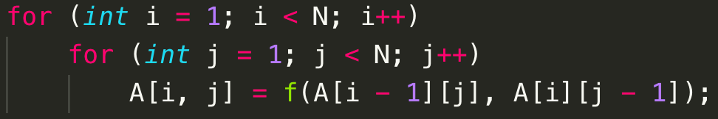
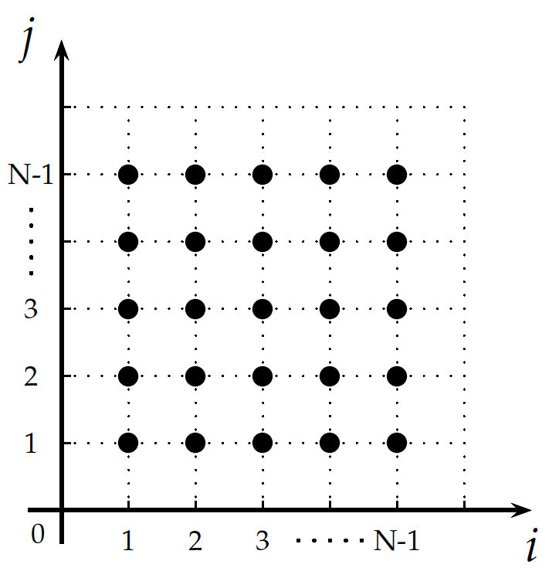
Polyhedral Model
{S[i, j] : 1 <= i <= N - 1 and 1 <= j <= N – 1}
Dependency:
{ S[i, j] -> A[i - 1, j] : 1 <= i <= N -1 and 1 <= j <= N- 1;
S[i, j] -> A[i, j - 1] : 1 <= i <= N - 1 and 1 <= j <= N -1 }

Slide 15
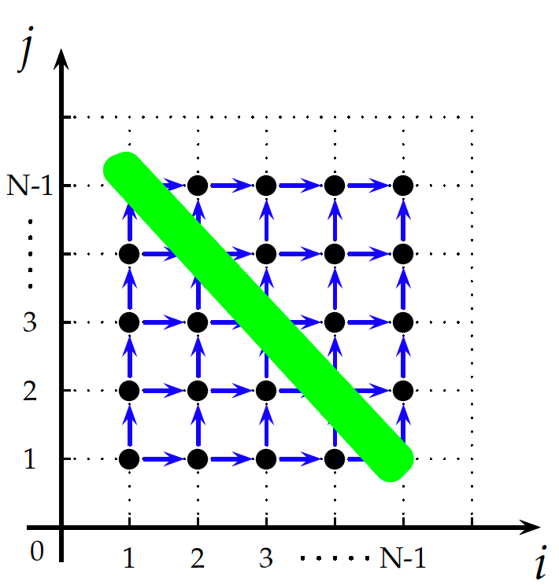
Polyhedral Model
{S[i, j] : 1 <= i <= N - 1 and 1 <= j <= N – 1}
Dependency:
{ S[i, j] -> A[i - 1, j] : 1 <= i <= N -1 and 1 <= j <= N- 1;
S[i, j] -> A[i, j - 1] : 1 <= i <= N - 1 and 1 <= j <= N -1 }
{ S[i, j] -> S[i, 1 + j] : 1 <= i <= N - 1 and 1 <= j <=N - 2;
S[i, j] -> S[i + 1, j] : 1 <= i <= N - 2 and 1 <= j <= N- 1 }
仿射变换变基：
{ S[i, j] -> [i + j, j]}

Slide 16
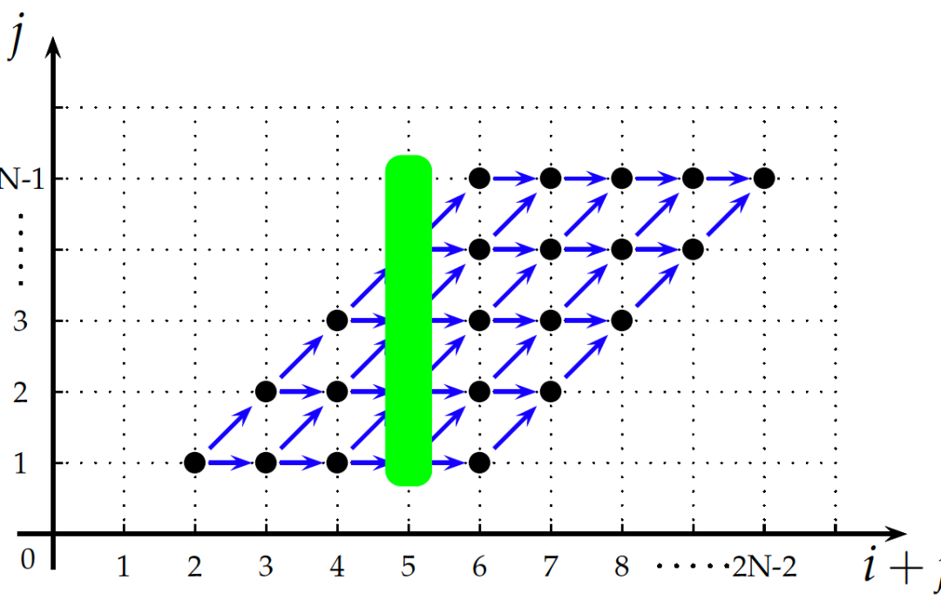
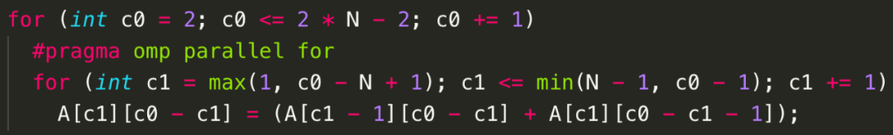
Polyhedral Model
{ S[i, j] -> S[i, 1 + j] : 1 <= i <= N - 1 and 1 <= j <=N - 2;
S[i, j] -> S[i + 1, j] : 1 <= i <= N - 2 and 1 <= j <= N- 1 }
仿射变换变基：
{ S[i, j] -> [i + j, j]}

Slide 17
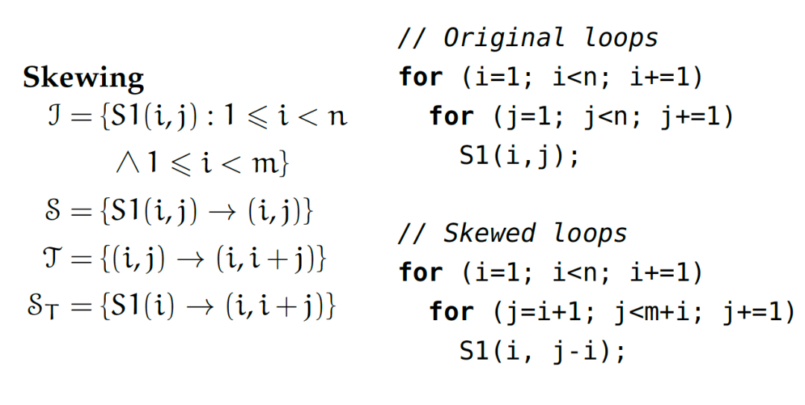
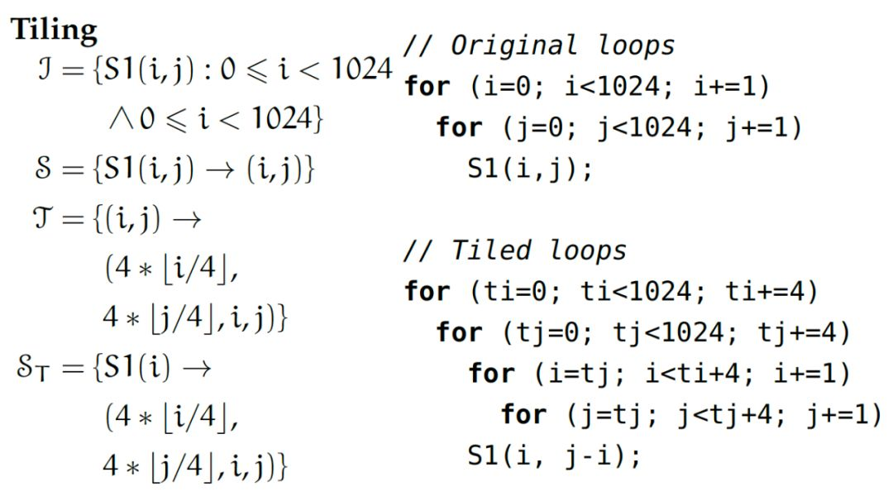
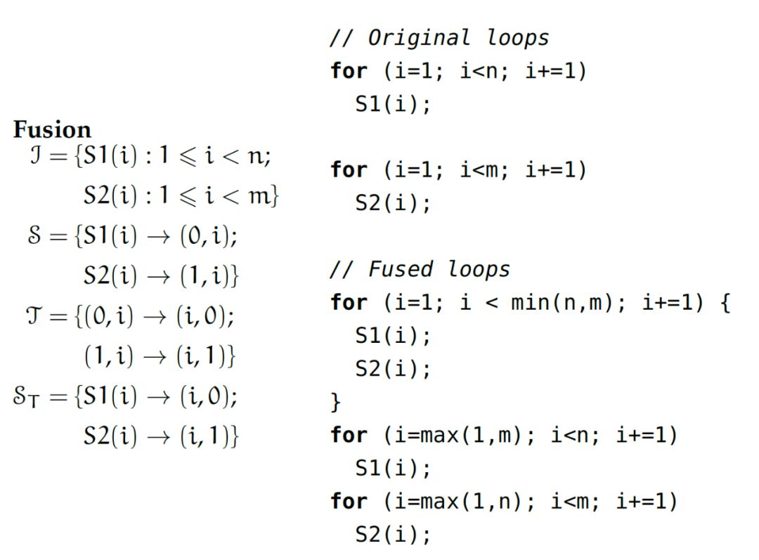
Polyhedral Model

Slide 18
Polyhedral Model
Advantages
promote parallelism and spatial/temporal data locality
Polyhedral compilers can also automatically go through complex verification processes to ensure that the semantics of their input program is preserved throughout this optimization phase.
it is also fully automatic and doesn’t require any hint from programmers apart from source-code in a C-like format.
Limitations in Triton
the set of possible program transformations is large, and grows with the number of statements in the program as well as with the size of their iteration domain.
the polyhedral framework is not very generally applicable; SCoPs(Static Control Parts) are relatively common but require loop bounds and array subscripts to be affine functions of loop indices, this framework still has to be successfully applied to sparse – or even structured-sparse – neural networks.

Slide 19
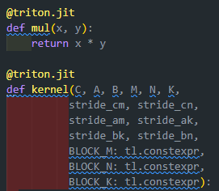
To be solved
def _attn_fwd_inner
def _attn_fwd
def _attn_bwd_preprocess
……
Why the two function must be separated into two file to compile?
How to build a file with multiple kernels?

Slide 20
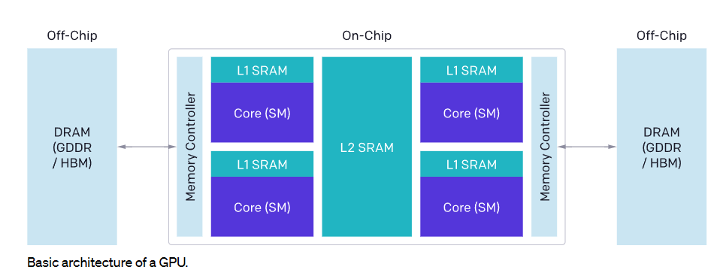
Triton
The architecture of modern GPUs can be roughly divided into three major components—DRAM, SRAM and ALUs—each of which must be considered when optimizing CUDA code:
Memory transfers from DRAM must be coalesced into large transactions to leverage the large bus width of modern memory interfaces.
Data must be manually stashed to SRAM prior to being re-used, and managed so as to minimize shared memory bank conflicts upon retrieval.
Computations must be partitioned and scheduled carefully, both across and within Streaming Multiprocessors (SMs), so as to promote instruction/thread-level parallelism and leverage special-purpose ALUs (e.g., tensor cores).

Slide 21
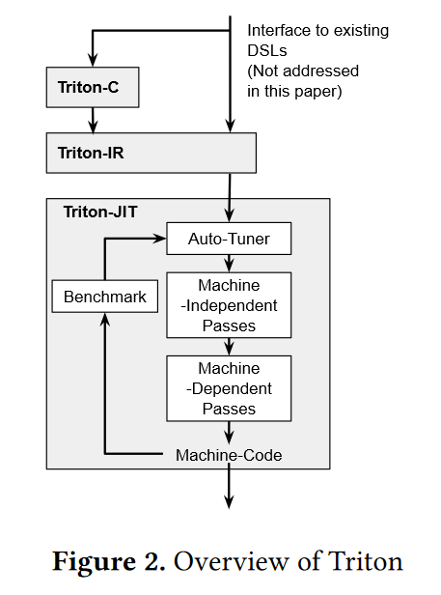
Introduction
Tensor-level IRs
XLA Glow
The polyhedral model
Tensor Comprehensions (TC) and Diesel
Loop synthesizers
Halide and TVM

Slide 22
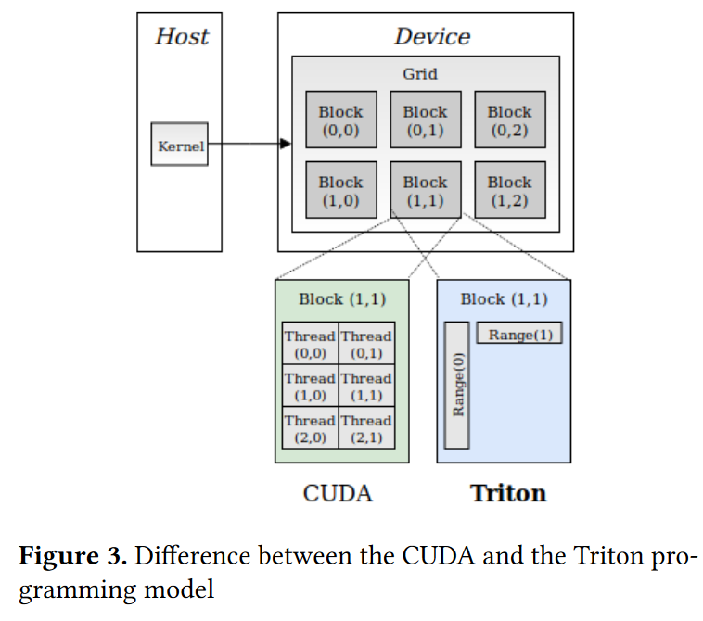
Triton-C Language
Syntax
The syntax of Triton-C is based on that of CUDA-C
Built-in Functions
various built-in functions (dot, trans, get_global_range) were added to support tile semantics
Broadcasting
N-dimensional tiles can be broadcast along any particular axis using the newaxis keyword and usual slicing syntax
Predication
Basic control-flow within tile operations is achieved through the use of predicated statements via the ’@’ prefix.

Slide 23
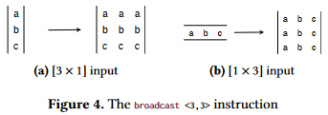
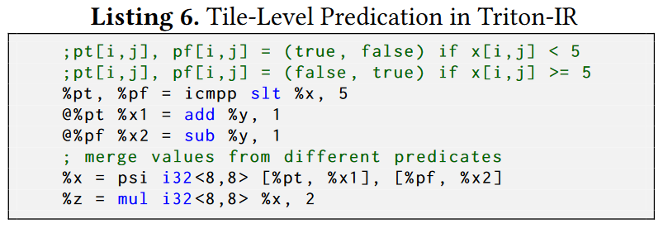
Triton-IR
LLVM-based
Support for Tile-Level Analysis
Structure
Modules
These modules are compiled independently and eventually aggregated by a linker.
Functions
Function attributes (such as inlining hints) and parameter attributes (such as read-only, aliasing hints) can also be specified.
Basic Blocks
assigned to only once and defined before being used.

Slide 24
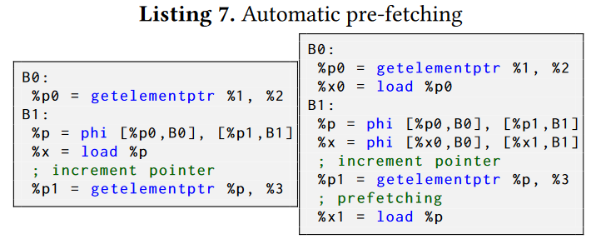
Triton-JIT Compiler
Machine-Independent Passes
Tile-level memory operation inside loops may induce severe latency that cannot be hidden in the absence of enough independent instructions.
Tile-Level Peephole Optimization
For instance, chains of transpositions can be simplified using the identity X = (XT )T for any tile X

Slide 25
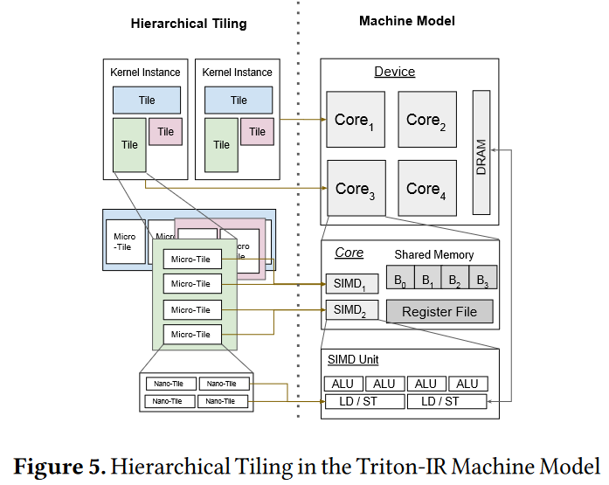
Triton-JIT Compiler
Machine-Dependent Passes
hierarchical tiling
memory coalescing
shared memory allocation
shared memory synchronization

Slide 26
Triton-JIT Compiler
Hierarchical Tiling
Nested tiling strategies aim at decomposing tiles into micro-tiles and eventually nano-tiles in order to fit a machine’s compute capabilities and memory hierarchy as tightly as possible.

Slide 27
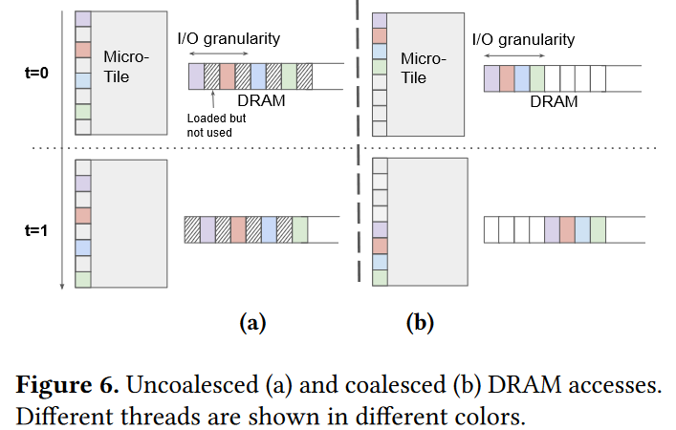
Triton-JIT Compiler
Memory Coalescing
Memory accesses are said to be coalesced when adjacent threads simultaneously access nearby memory locations.
Because Triton-IR programs are single-threaded and automatically parallelized, our compiler backend is able to order threads internally within each micro-tile so as to avoid uncoalesced memory accesses when possible.

Slide 28
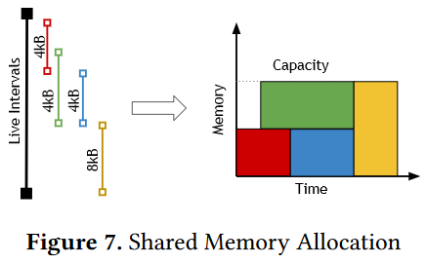
Triton-JIT Compiler
Shared Memory Allocation
Tile-level operations that have high arithmetic intensity (e.g., dot) can benefit from temporarily storing their operands in fast shared memory. The purpose of the Shared Memory Allocation pass is to determine when and where a tile should be stashed to this space. by first calculating the live range of each variable of interest, and then using the linear-time storage allocation algorithm proposed in.

Slide 29
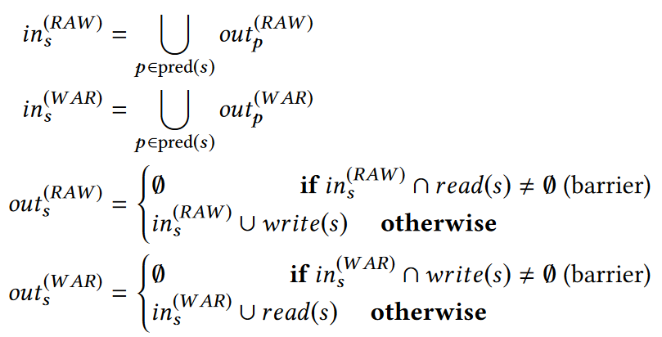
Triton-JIT Compiler
Shared Memory Synchronization
Reads from and write to shared memory are asynchronous in our machine model. The goal of the Shared Memory Synchronization pass automatically inserts barriers in the generated GPU source code so as to preserve program correctness. This is done by detecting read-after-writes (RAW) and write-after-read(WAR) hazards using forward data-flow analysis with the following data-flow equations:

Slide 30
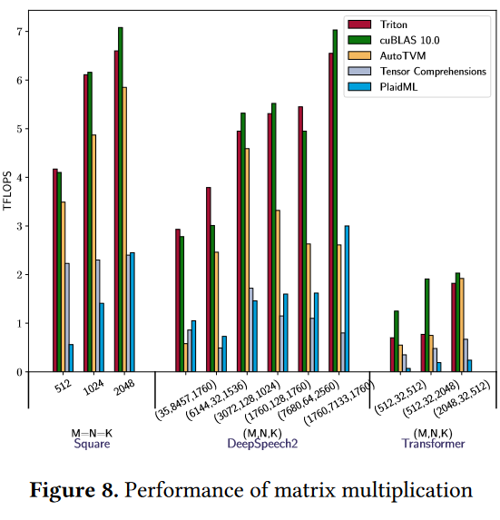
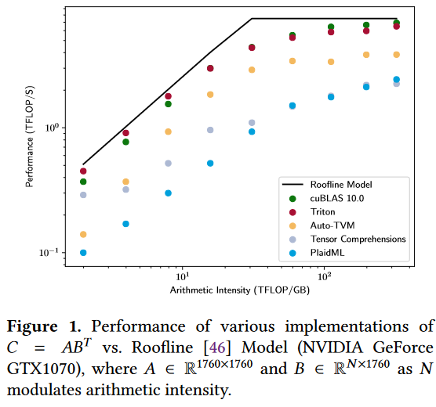
Experiments

Slide 31


